Slide 1



DeFIX: Detecting and Fixing Failure Scenarios with Reinforcement Learning in Imitation Learning Based Autonomous Driving
The 25th IEEE International Conference on Intelligent Transportation Systems (IEEE ITSC 2022)
October 8-12, 2022, Macau, China Resul Dagdanov, Feyza Eksen, Halil Durmus, Ferhat Yurdakul, and Nazim Kemal Ure
- Istanbul Technical University - ITU Artificial Intelligence and Data Science Research Center
- Eatron Technologies
The 25th IEEE International Conference on Intelligent Transportation Systems (IEEE ITSC 2022)
Slide No. 1

Slide 2
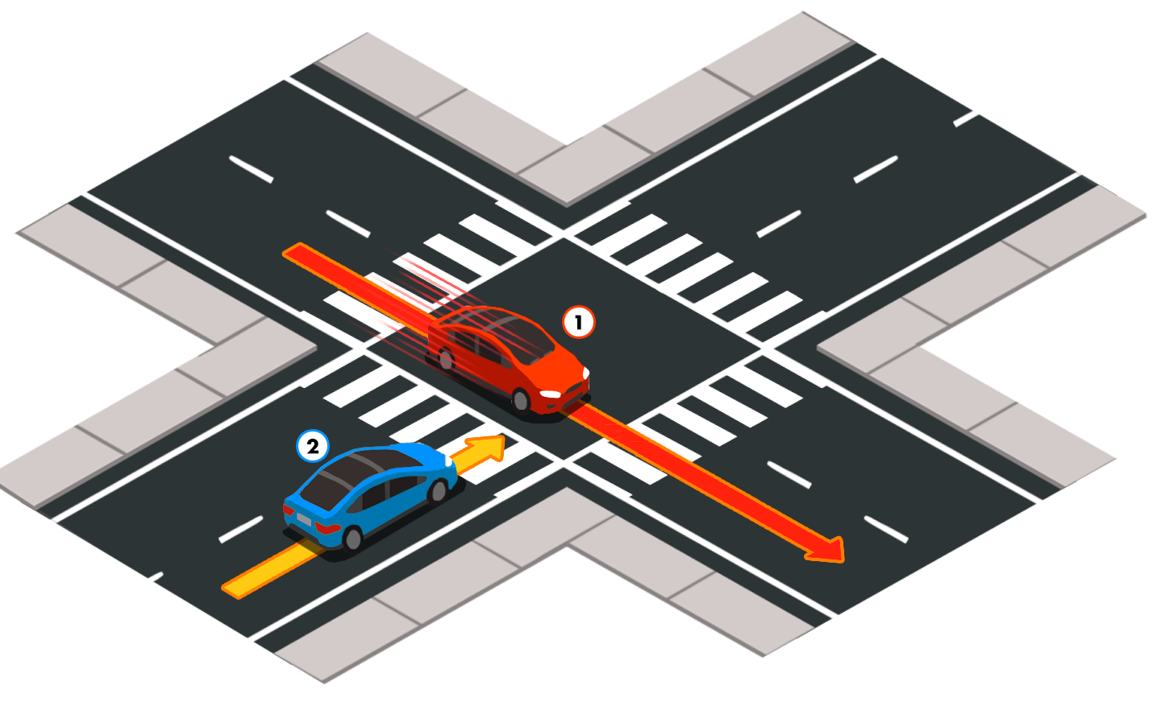
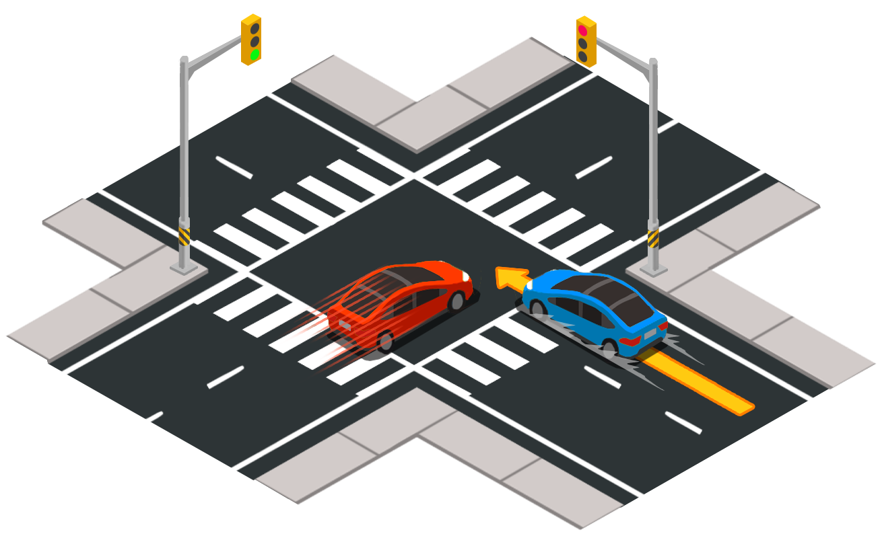
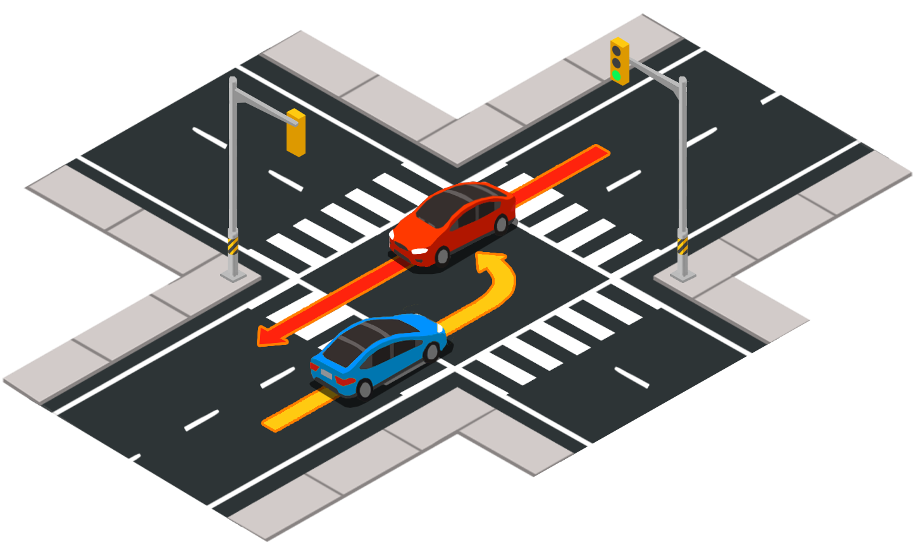
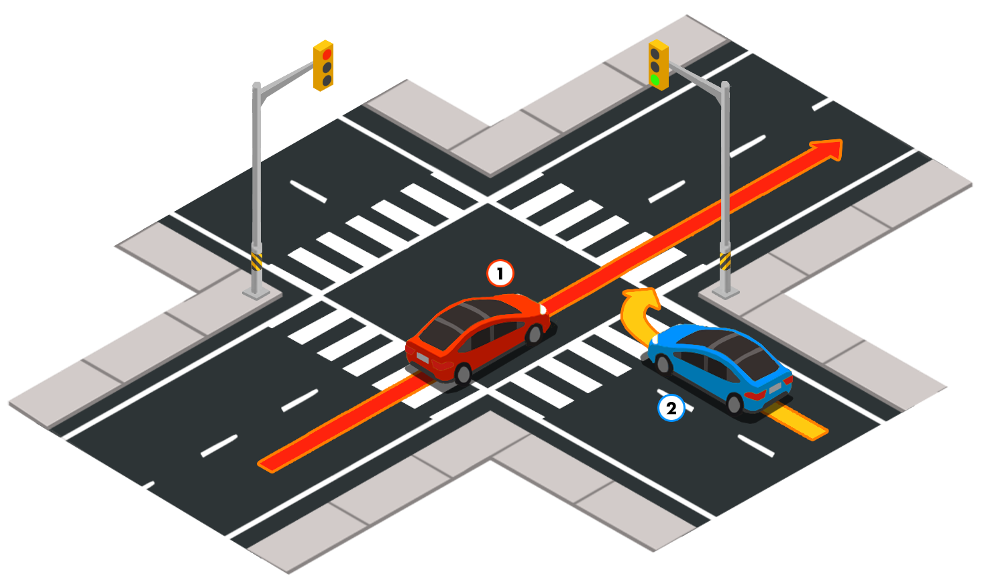
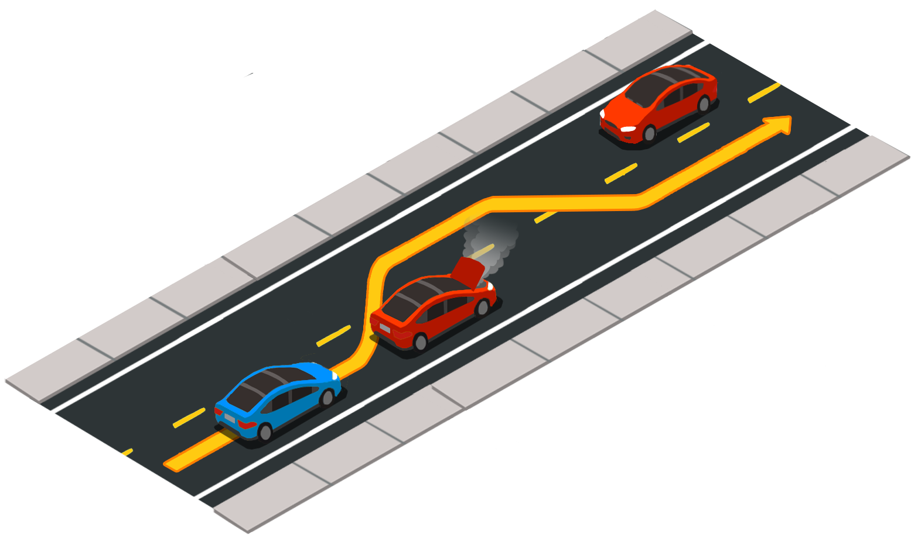
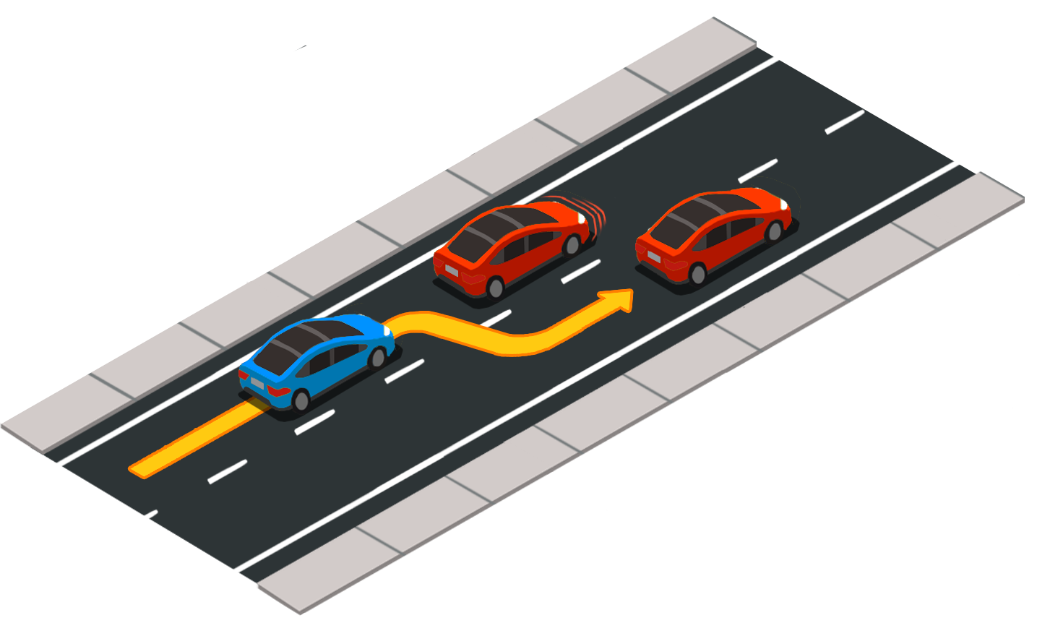
Problem Statement
Decision making in adversarial urban driving scenarios is a hard problem.
Designing a perfect rule-based agent would necessitate a lot of hard-coding to tackle these scenarios.
Objective is to come up with a methodology that solves shortcomings of suboptimal policy.
CARLA Challenge environment is chosen as it features state-of-the-art urban driving scenarios:
vehicles run in red lights
pedestrians cross the road irregularly
decisions in uncontrolled traffic intersections occur
vehicles get stuck on the road
https://carla-scenariorunner.readthedocs.io/en/latest/list_of_scenarios/
The 25th IEEE International Conference on Intelligent Transportation Systems (IEEE ITSC 2022)
Slide No. 2

Slide 3
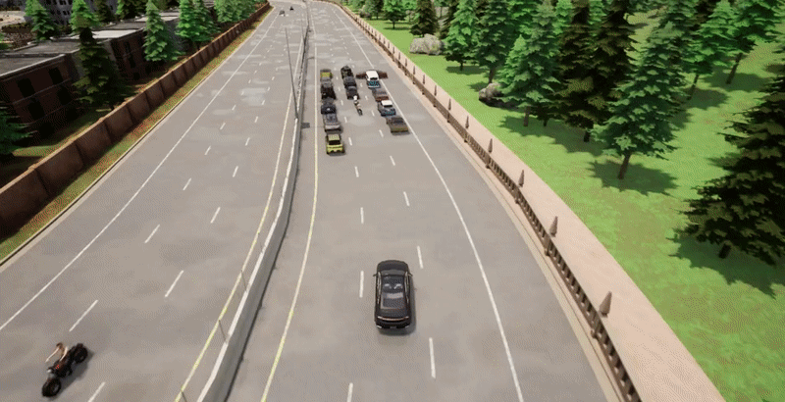
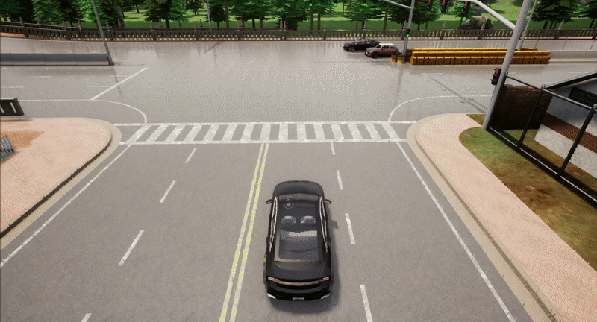
Motivation
autopilot vehicle gets stuck
autopilot vehicle brakes late
Hard-coded autopilot is sensitive to predefined rules.
Impossible to generalize with rule-based system.
Imitating a suboptimal policy will result in a lack of performance of trained model.
General methodology / framework is required to efficiently solve safe autonomous driving tasks.
The 25th IEEE International Conference on Intelligent Transportation Systems (IEEE ITSC 2022)
Slide No. 3

Slide 4
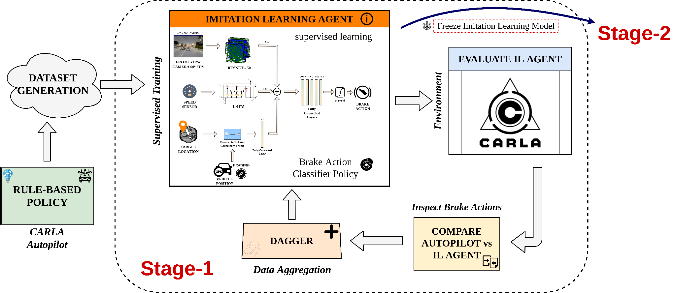
Methodology (Stage-1)
Stage-1:
Dataset is created from autopilot demonstrations.
Imitation Learning agent is trained with behavioral cloning.
Trained model is continuously improved with DAgger technique.
IL agent is freezed after multiple DAgger approaches until performance reaches an autopilot performance.
The 25th IEEE International Conference on Intelligent Transportation Systems (IEEE ITSC 2022)
Slide No. 4

Slide 5
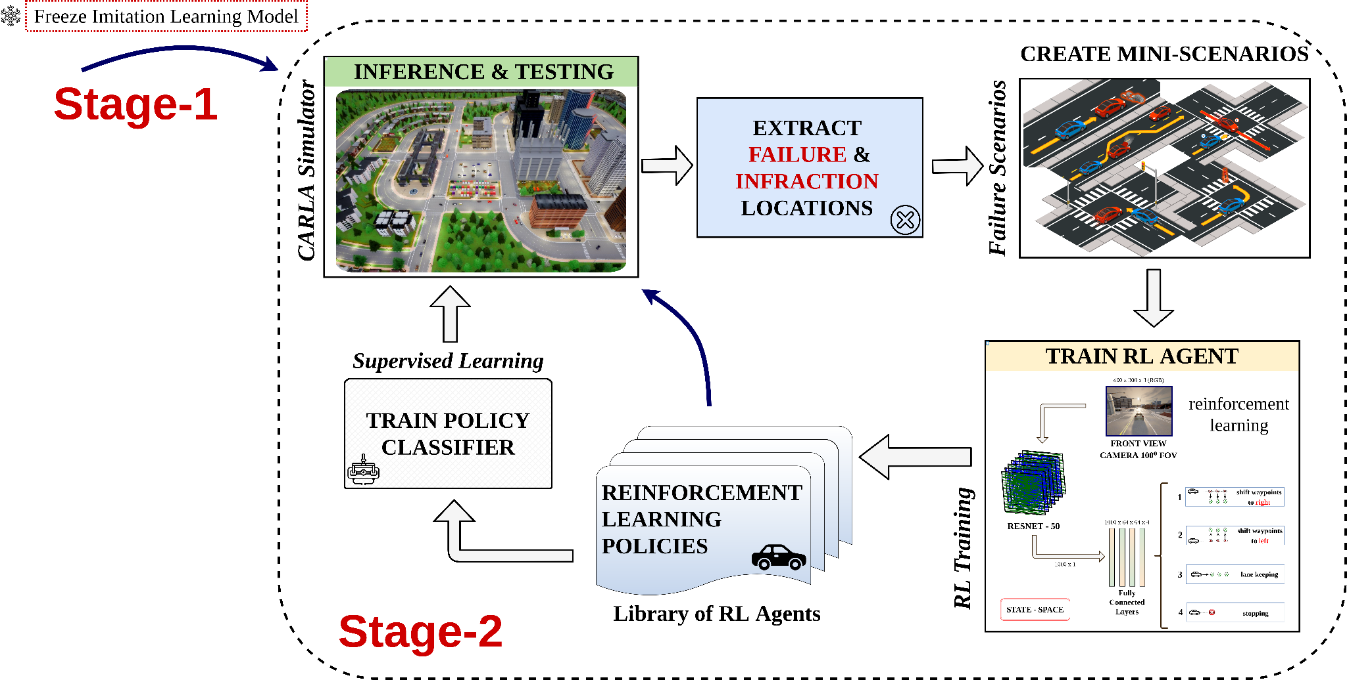
Methodology (Stage-2)
Stage-2:
Trained IL model is freezed and tested in the simulation.
Mini-scenarios are constructed from infraction locations.
Online RL agent is trained on one of the mini-scenarios.
Library of trained policies is extended with newly trained RL agent.
Policy classifier network is trained in a supervised manner with ground truth determined from reward function.
The 25th IEEE International Conference on Intelligent Transportation Systems (IEEE ITSC 2022)
Slide No. 5

Slide 6
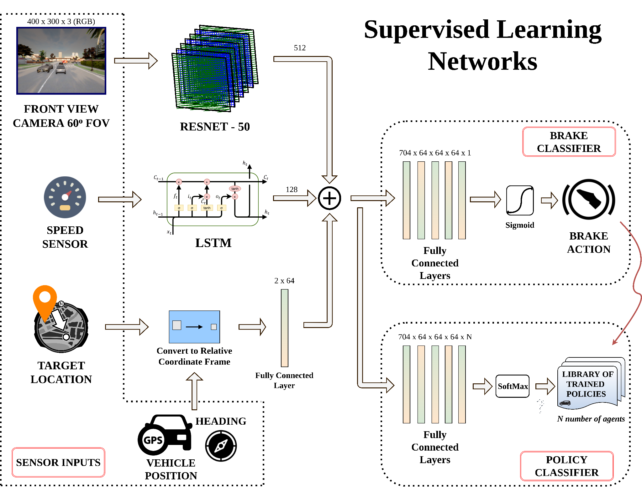
Network Architectures
Freezed Resnet-50 image backbone.
Low-level PID controllers for throttle and steering actions.
Ground truth labels for Policy Classifier are determined with reward function.
Imitation Learning Agent Model
Policy Classifier Model
The 25th IEEE International Conference on Intelligent Transportation Systems (IEEE ITSC 2022)
Slide No. 6

Slide 7
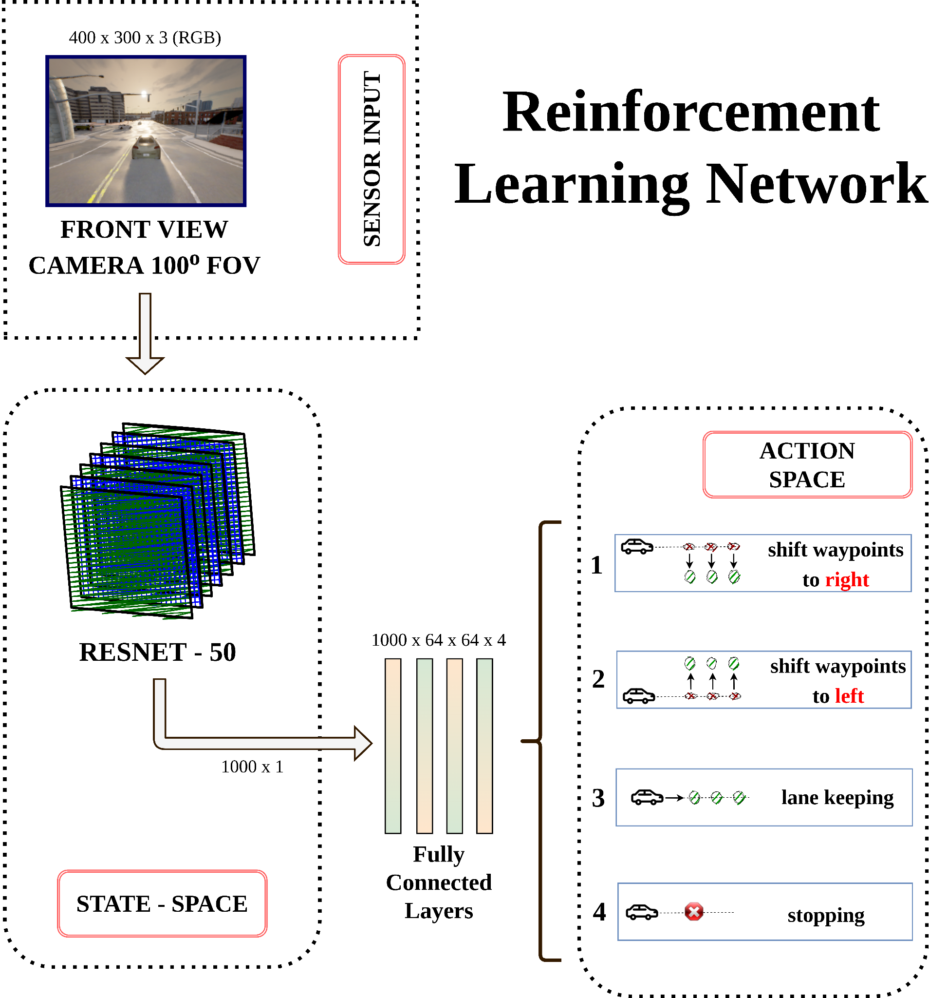
Network Architectures
DQN model is trained.
Image backbone is completely frozen.
State-space of RL agents is an image backbone features.
Low-level PID controllers for throttle and steering movements.
Generalized action states are:
Left lane change
Right lane change
Lane Keep
Stop
The 25th IEEE International Conference on Intelligent Transportation Systems (IEEE ITSC 2022)
Slide No. 7

Slide 8
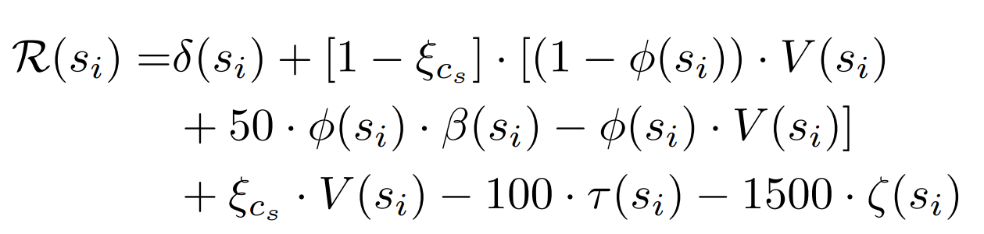
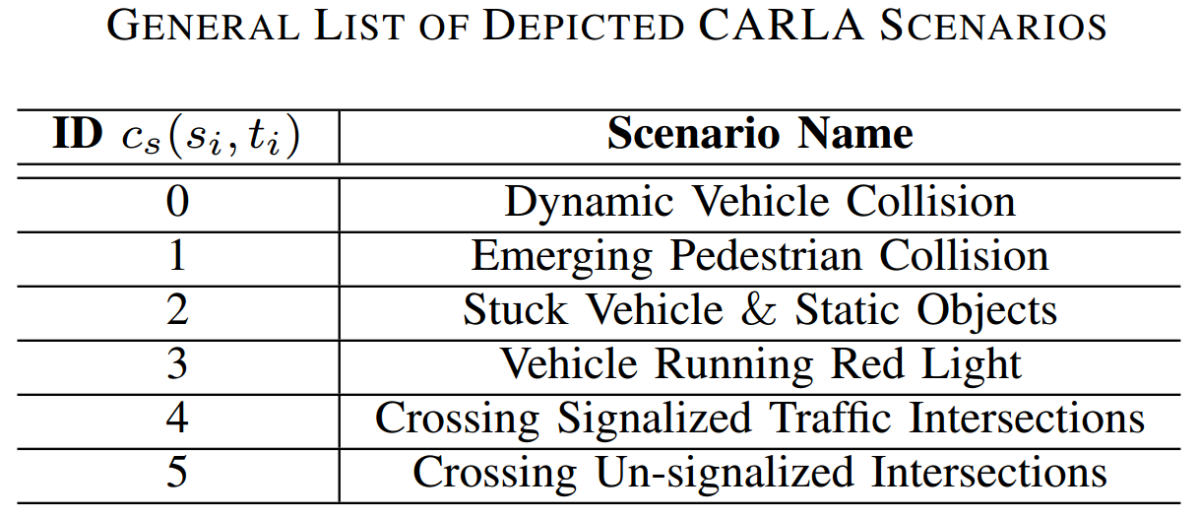
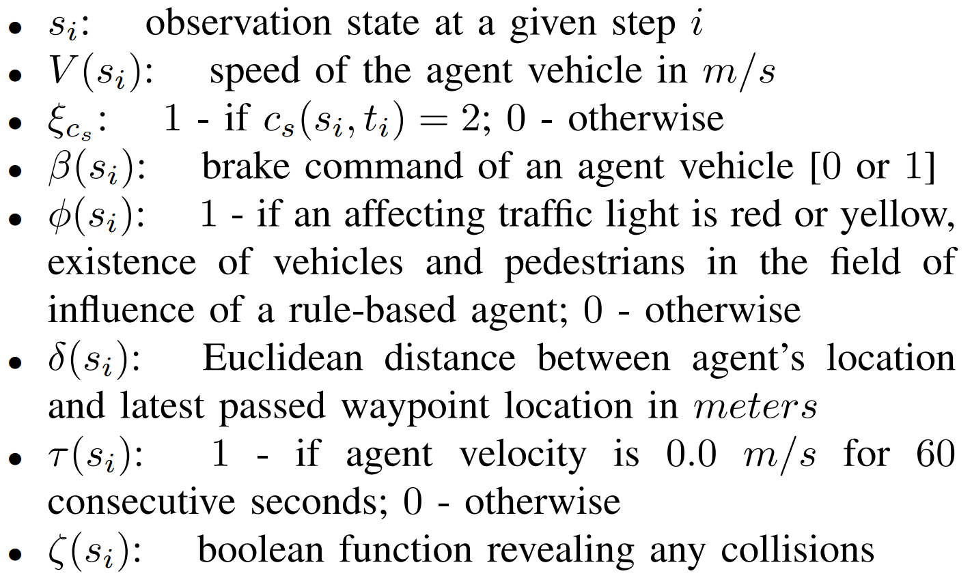
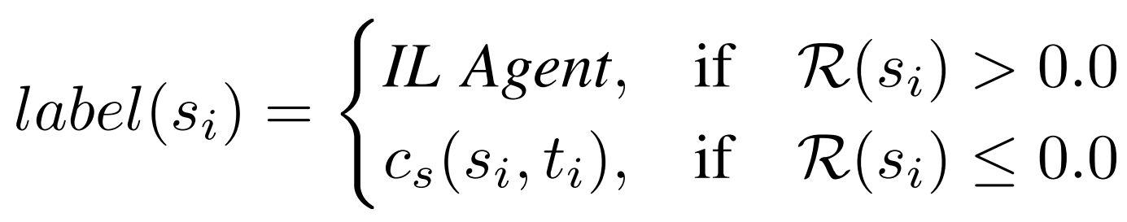
Experiments (Reward Function)
The 25th IEEE International Conference on Intelligent Transportation Systems (IEEE ITSC 2022)
Slide No. 8

Slide 9
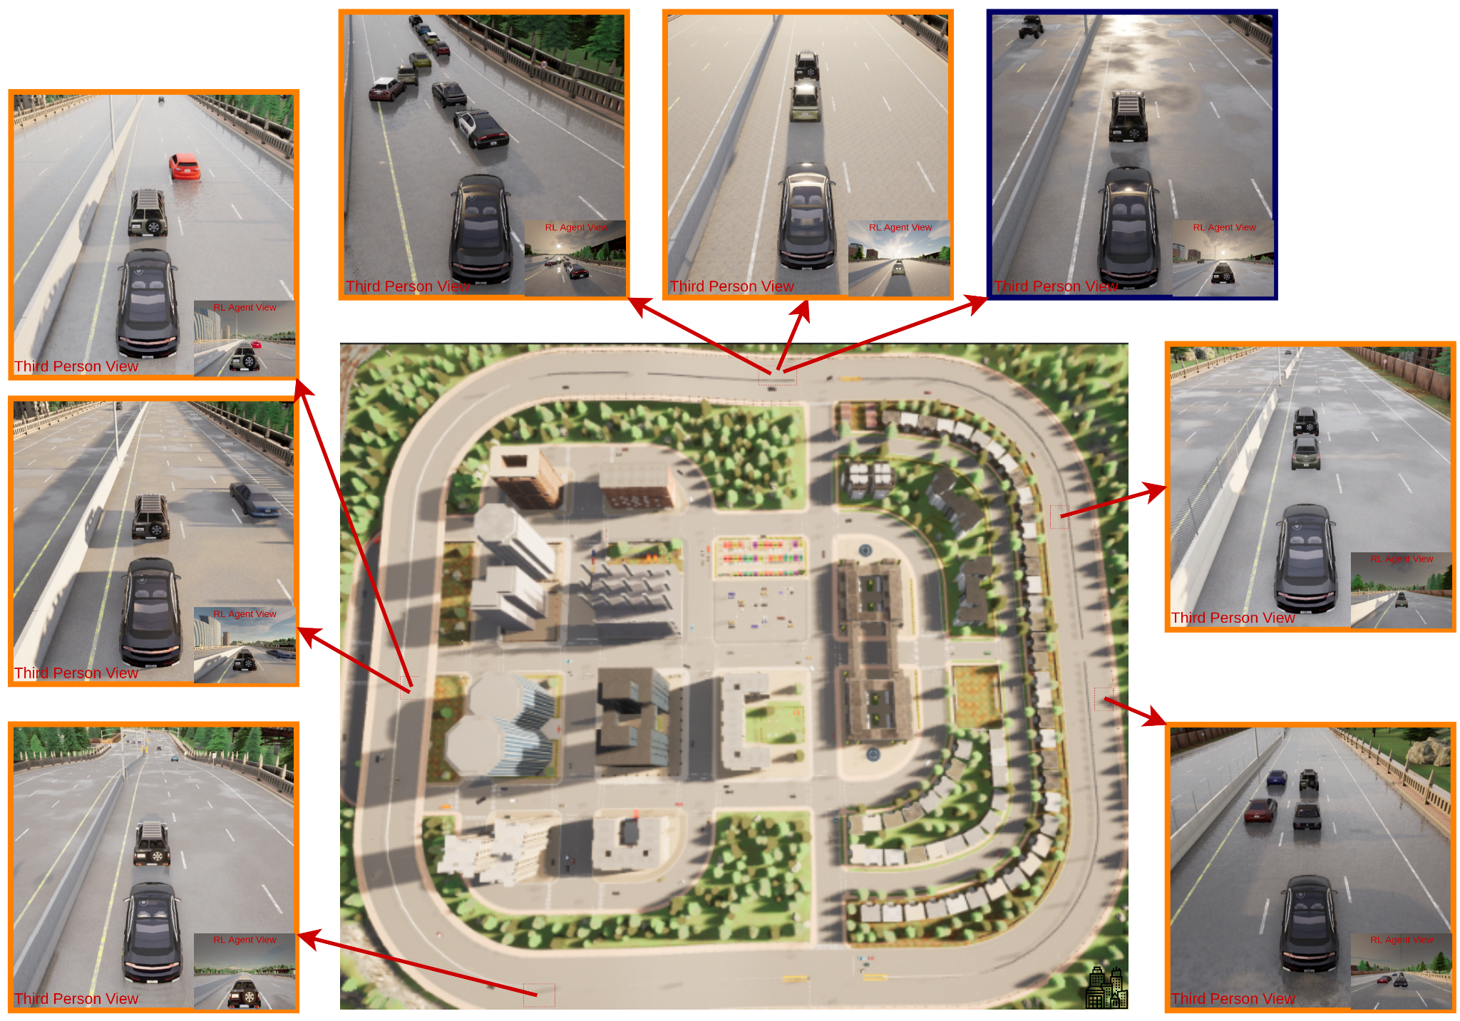
Experiments (RL Training)
An autopilot and an imitation learning agent gets stuck in these scenarios and could not make lane changing maneuvers.
One mini-scenario of stuck vehicle case is constructed and DQN agent is trained on this scenario.
To generalize, weather conditions are dynamically changed at every 20 steps while training RL agent.
At each training episode, RL agent is initialized randomly at a distance 3 meters to 10 meters to the infraction location.
Stuck Vehicle Scenarios
in Town05 Map
Blue: Training Scenario
Orange: Evaluation Scenarios
The 25th IEEE International Conference on Intelligent Transportation Systems (IEEE ITSC 2022)
Slide No. 9

Slide 10
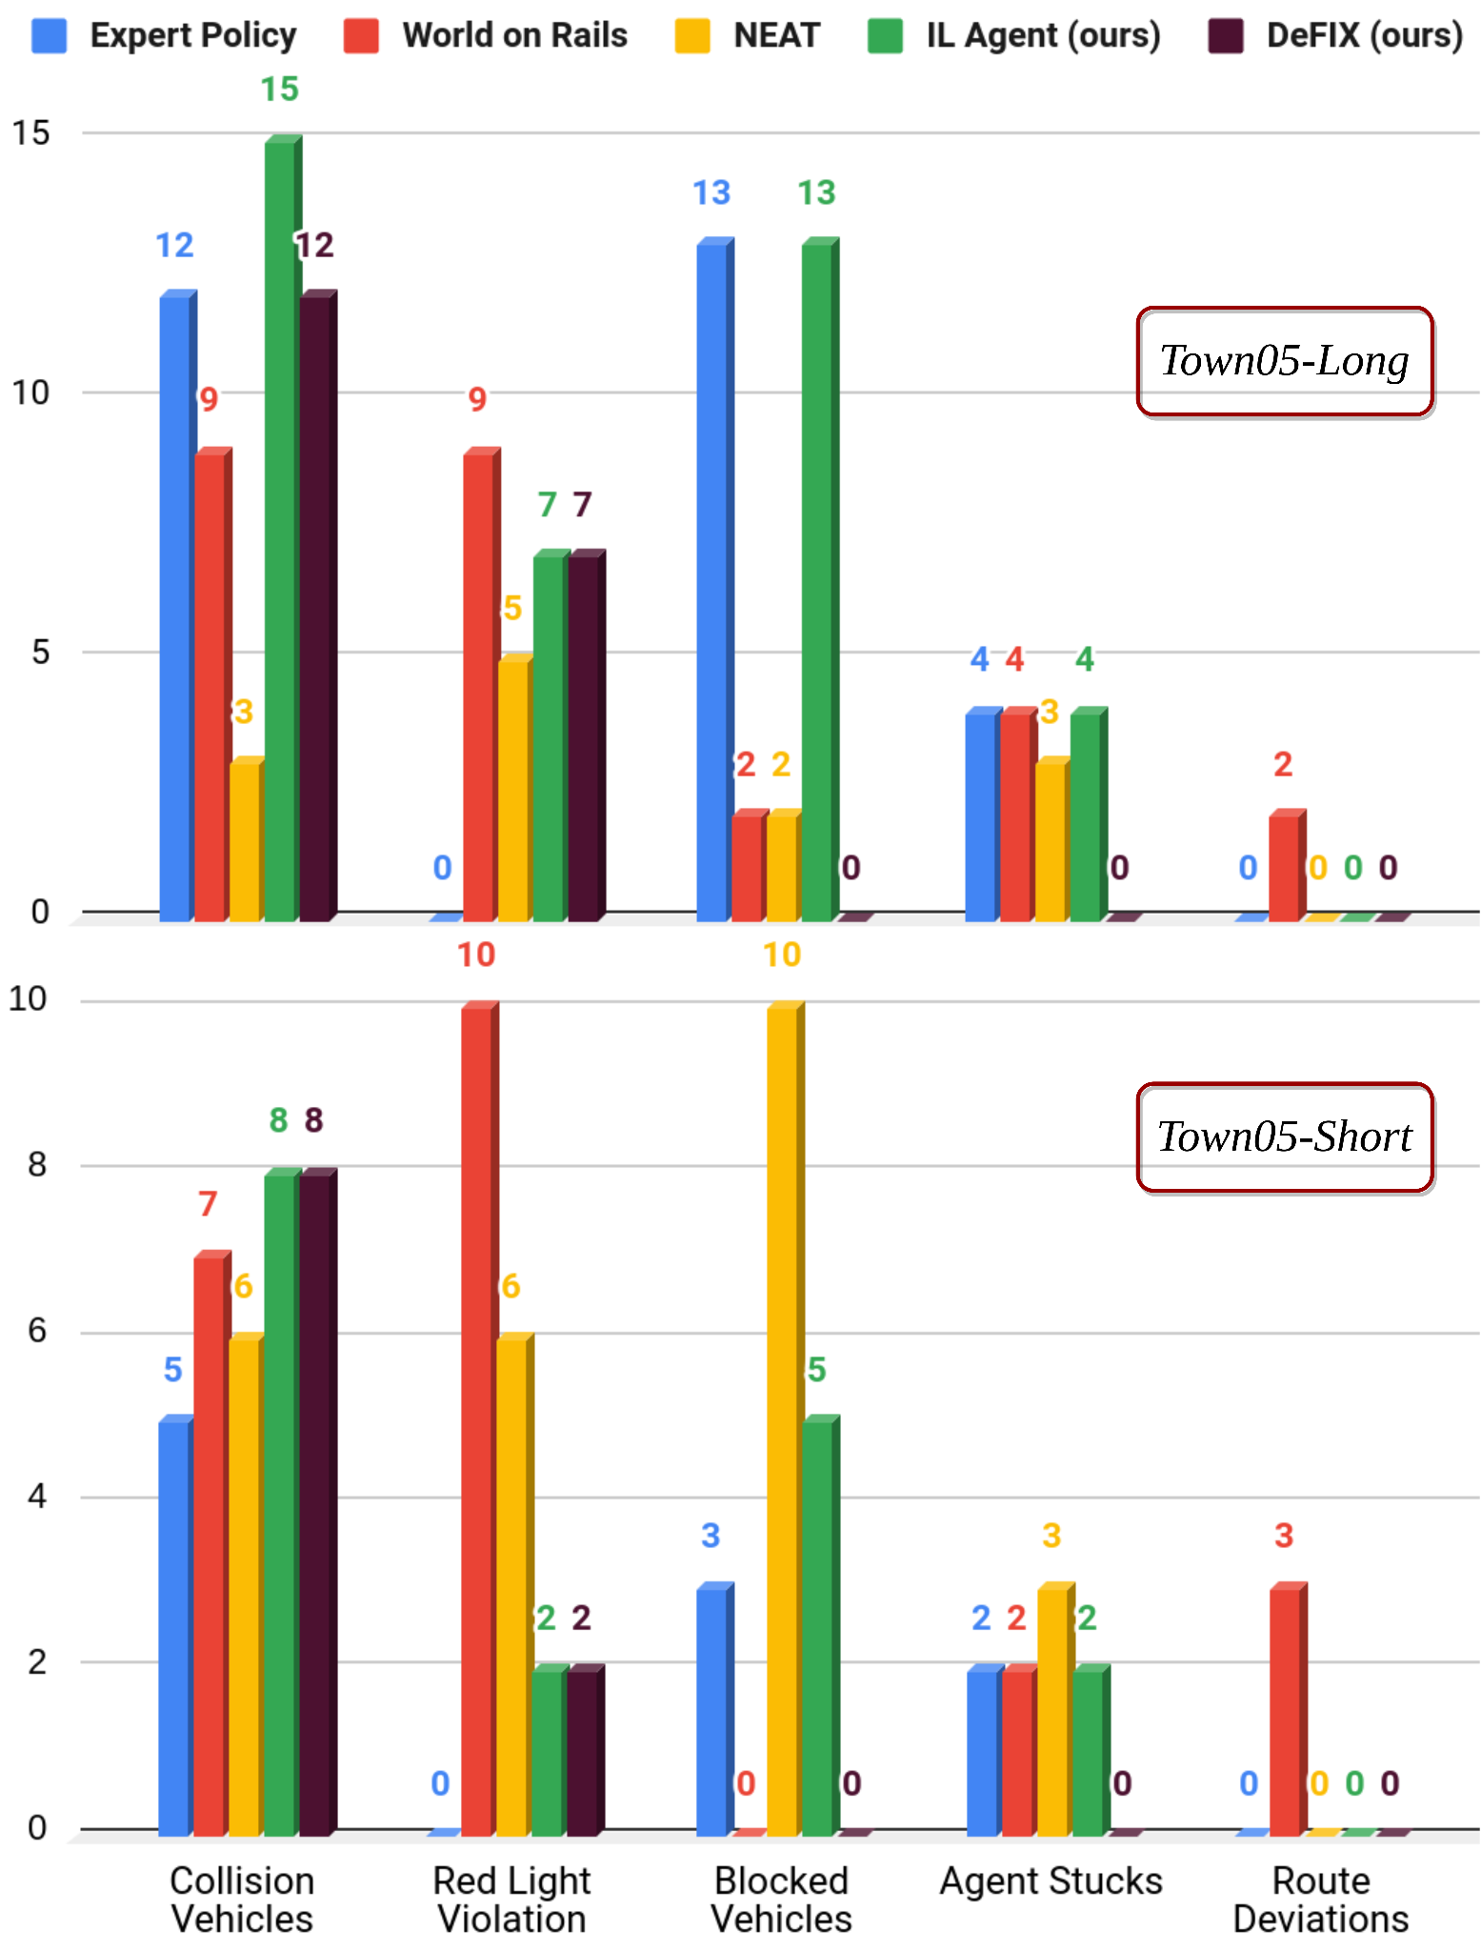
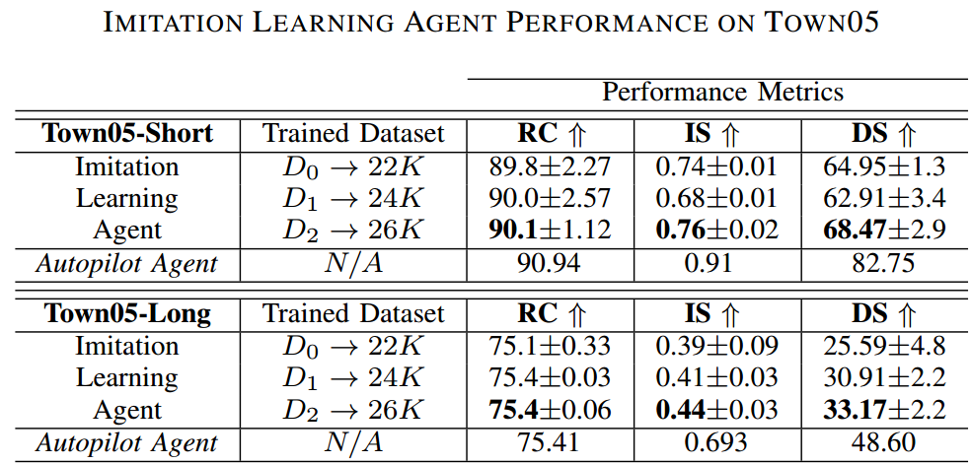
Results
RC: Route Completion (higher is better)
IS: Infraction Score (higher is better)
DS: Driving Score (higher is better)
Total Number
of Infractions
The 25th IEEE International Conference on Intelligent Transportation Systems (IEEE ITSC 2022)
Slide No. 10

Slide 11
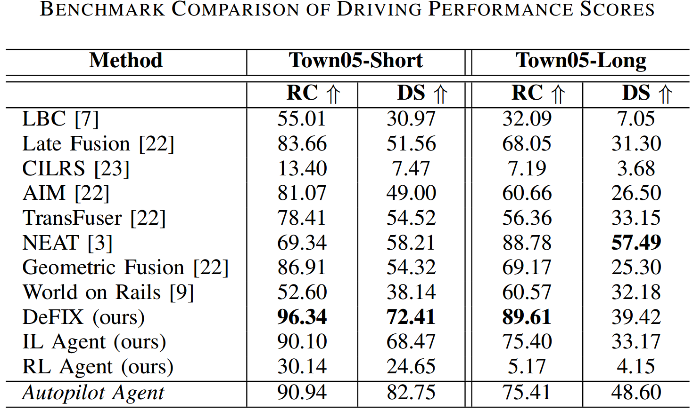
Results
RC: Route Completion (higher is better)
DS: Driving Score (higher is better)
DeFIX outperforms state-of-the-art benchmark.
Better RC score than autopilot with only relying on sensor information without privileged knowledge.
Achieve %15 better RC score and %3 closer DS.
Town05 is the most challenging map of CARLA challenge environment.
The 25th IEEE International Conference on Intelligent Transportation Systems (IEEE ITSC 2022)
Slide No. 11

Slide 12
Conclusion
Imitation learning policy is limited with the performance of the demonstrator policy.
Proposed and tested a new methodology called DeFIX.
Achieved better DS and RC scores than the methods in the literature on the most challenging map.
The future of this research:
Extensive tests on different maps.
Expand the library of RL agents and breaden the effectiveness.
Carry the evaluation of DeFIX method into official CARLA challenge.
The 25th IEEE International Conference on Intelligent Transportation Systems (IEEE ITSC 2022)
Slide No. 12

